Slide 1
EC 1308 - RF & Microwave Engineering IMPATT Diode and TRAPATT Diode
Submitted To:-
Dr . Taimoor Khan
ECE
Submitted By:-
Prashant Jha
17-14-119

Slide 2
IMPATT Diode

Slide 3
IMPATT Diode
IMPact ionization Avalanche Transit Time Diode
Sometimes Referred to as Read diode (Original idea proposed by W. T. Read and Ralph L. Johnston in1956)
It is high power Semiconductor Diode used in used in high-frequency microwave electronics devices.
Operates at frequency range of 3GHz to 100GHz
Advantage:- It has high Power handling capacity (up to 3 kilowatts)
Disadvantage:- High level of Phase noise

Slide 4
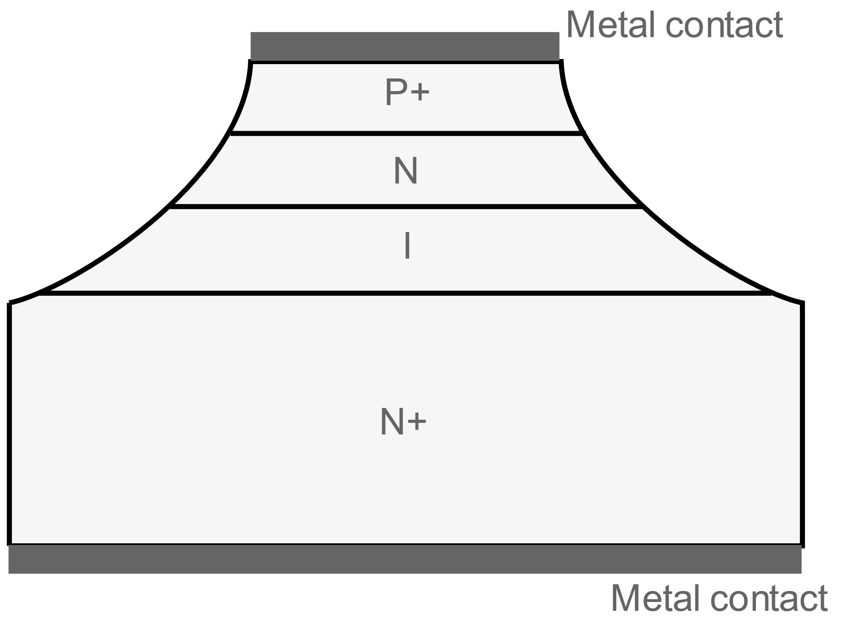
IMPATT Diode Structure
It consists of 4 regions namely P⁺-N-I-N⁺
Materials like GaAs, Si, Ge or InP are used for its construction. (However, GaAs is preferred because of its low noise behavior)
The structures are all basic variations of the PN junction although often an intrinsic layer is placed between the P type and N type regions
The IMPATT diode structures are designed for optimum operation in reverse bias so that avalanche multiplication occurs within the high field region
Vertical Structure leads to high power handling capacity

Slide 5
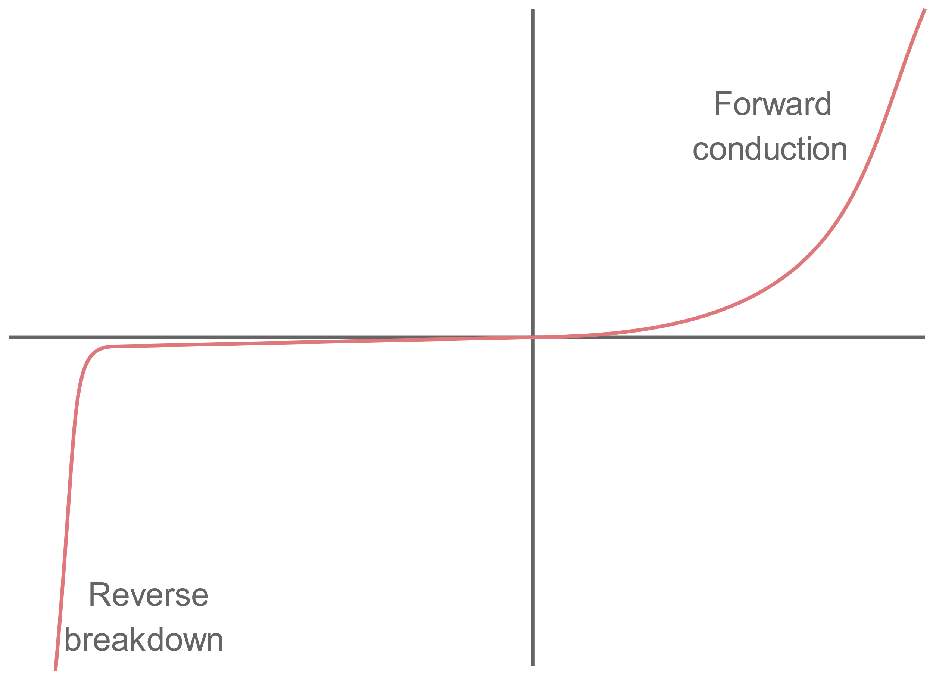
IMPATT Diode Working
It has a very similar I-V characteristic to any other form of PN junction diode.(It conducts in the forward direction once the turn on voltage has been reached. In the reverse direction it blocks current flow, until the diode breakdown voltage is reached)
For its operation as a microwave signal generator, IMPATT diode is operated under reverse bias conditions. (These are set so that avalanche breakdown occurs)
Breakdown occurs in the region very close to the P+ (i.e. heavily doped P region)
The electric field at the PN junction is very high because the voltage appears across a very narrow gap creating a high potential gradient.
Under these circumstances any carriers are accelerated very quickly which causes collisions with crystal lattice

Slide 6
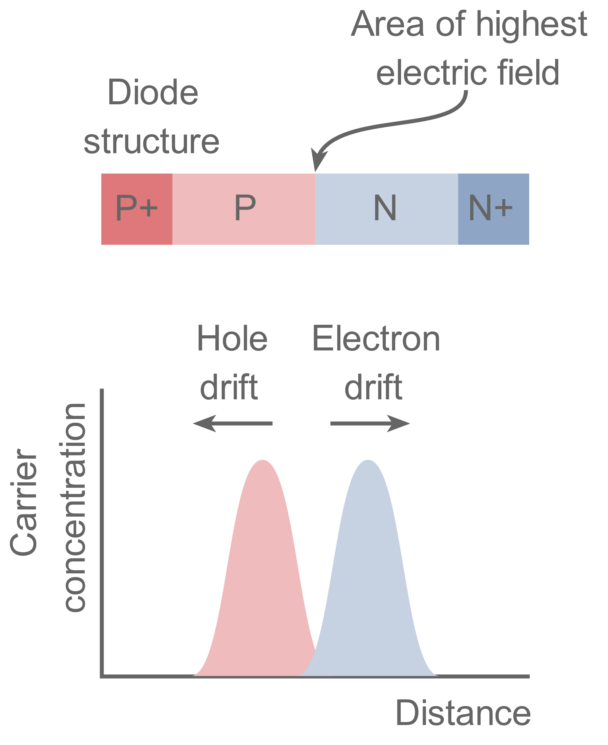
Cont.…
The subsequent collision creates more and more carriers which causes Avalanche Breakdown.(number of carriers multiplies very quickly)
This type of breakdown only occurs when a certain voltage is applied to the junction.
In terms of its operation the IMPATT diode can be considered to consist of two areas, namely the avalanche region or injection region, and secondly the drift region.
The avalanche or injection region creates the carriers which may be either holes of electrons
The drift region is where the carriers move across the diode taking a certain amount of time dependent upon its thickness.

Slide 7
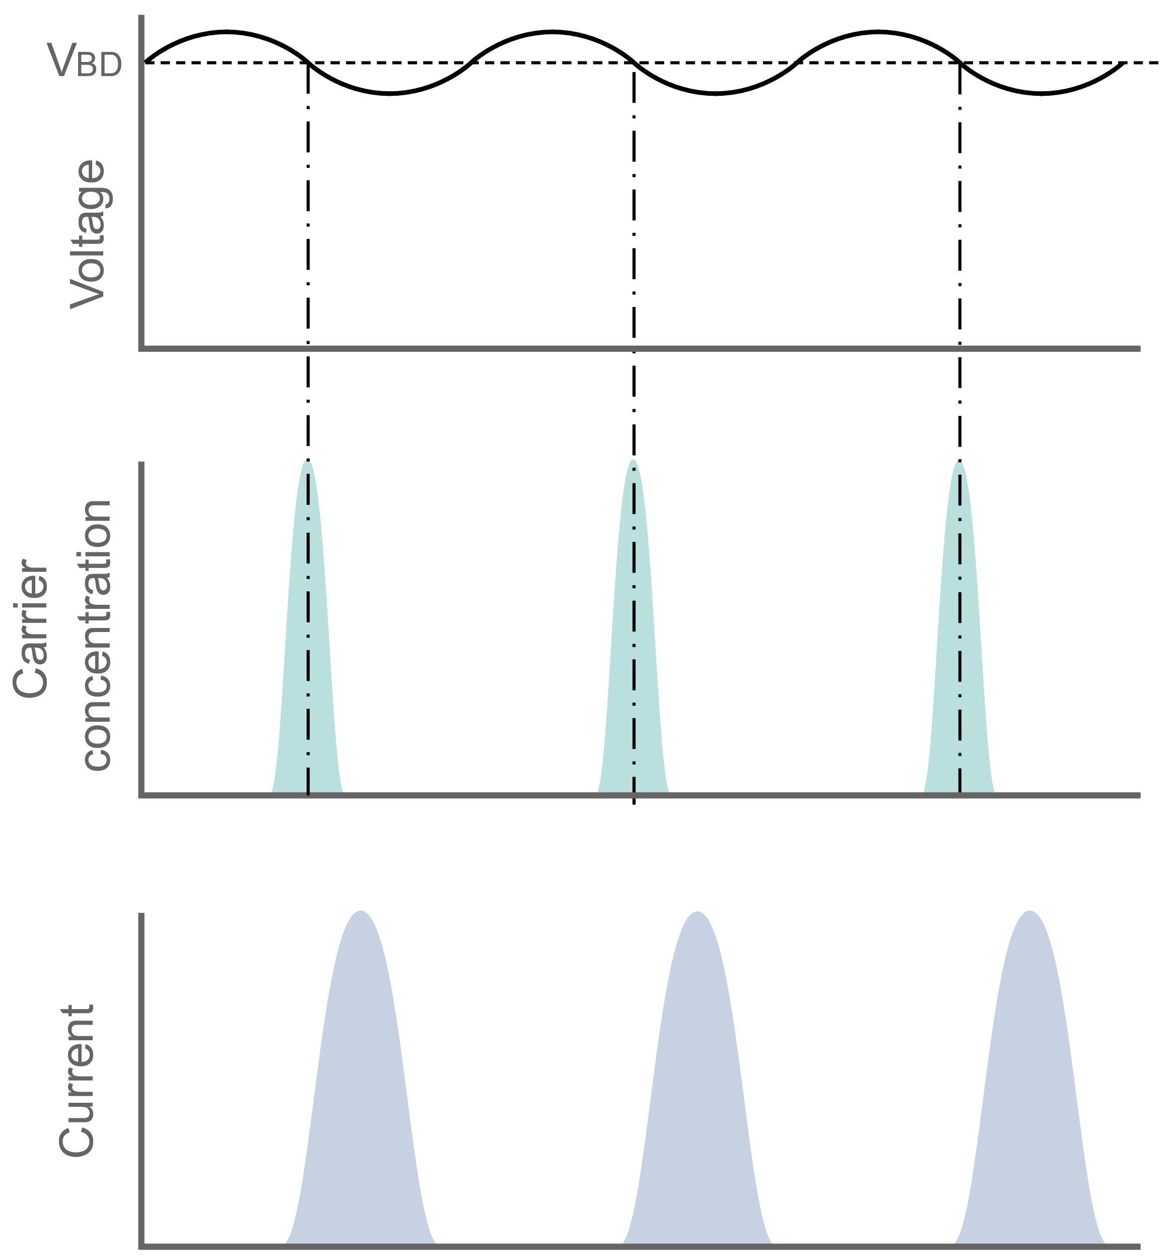
IMPATT Diode operation
Once the carriers have been generated the device relies on negative resistance to generate and sustain an oscillation
The effect does not occur in the device at DC, but instead, here it is an AC effect that is brought about by phase differences that are seen at the frequency of operation
When an AC signal is applied the current peaks are found to be 180° out of phase with the voltage
This results from two delays which occur in the device. (injection delay, and a transit time delay)
Generation of carriers does not occur in unison with the voltage variations. (generation of carriers is not only a function of the electric field but also the number of carriers already in existence)
As the electric field increases so does the number of carriers.

Slide 8
Cont.…
Even after the field has reached its peak the number of carriers still continues to grow as a result of the number of carriers already in existence.
This continues until the field falls to below a critical value when the number of carriers starts to fall.
As a result of this effect there is a phase lag so that the current is about 90° behind the voltage. (This is known as the injection phase delay.)
When the electrons move across the N+ region an external current is seen, and this occurs in peaks, resulting in a repetitive waveform.

Slide 9
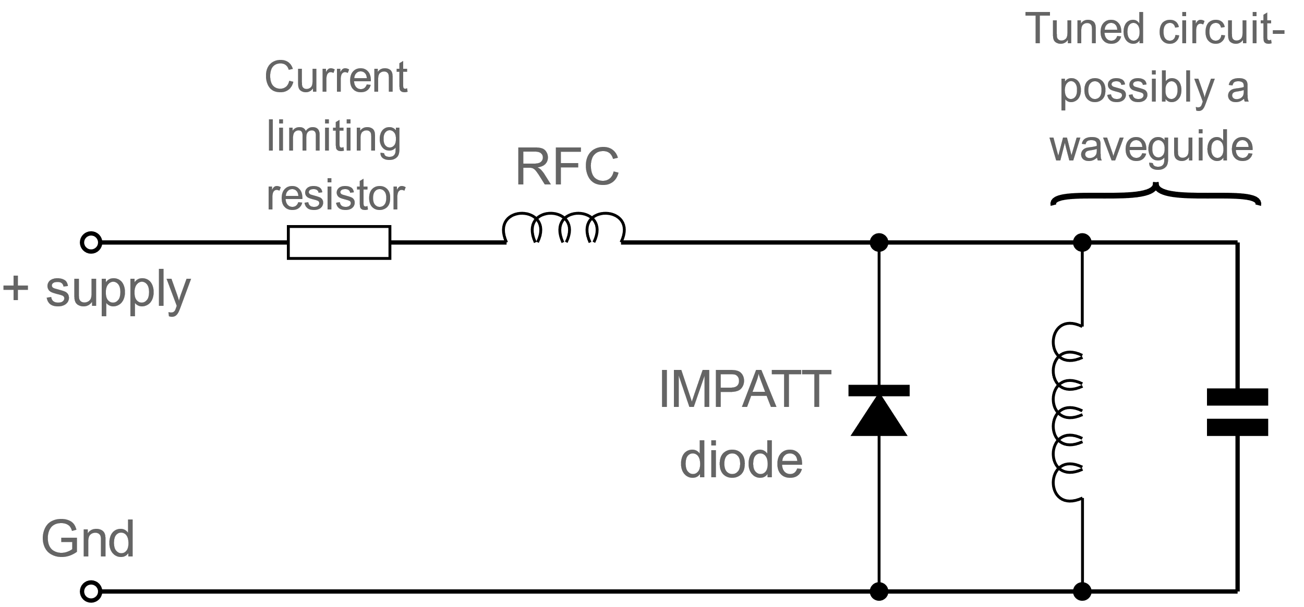
IMPATT Diode Circuits
IMPATT diodes are generally used at frequencies above about 3 GHz or more.
It is found that when a tuned circuit is applied along with a voltage around the breakdown voltage to the IMPATT, and oscillation will occur.
The IMPATT diode is driven from a supply through a current limiting resistor. The value of this limits the current to the value required.
The current is passed through an RF choke to isolate the DC from the radio frequency signal.
The IMPATT microwave diode is placed across the tuned circuit.
Typically the diode may be mounted in a waveguide cavity that provides the required tuned circuit.
Once the supply voltage is applied the circuit will oscillate

Slide 10
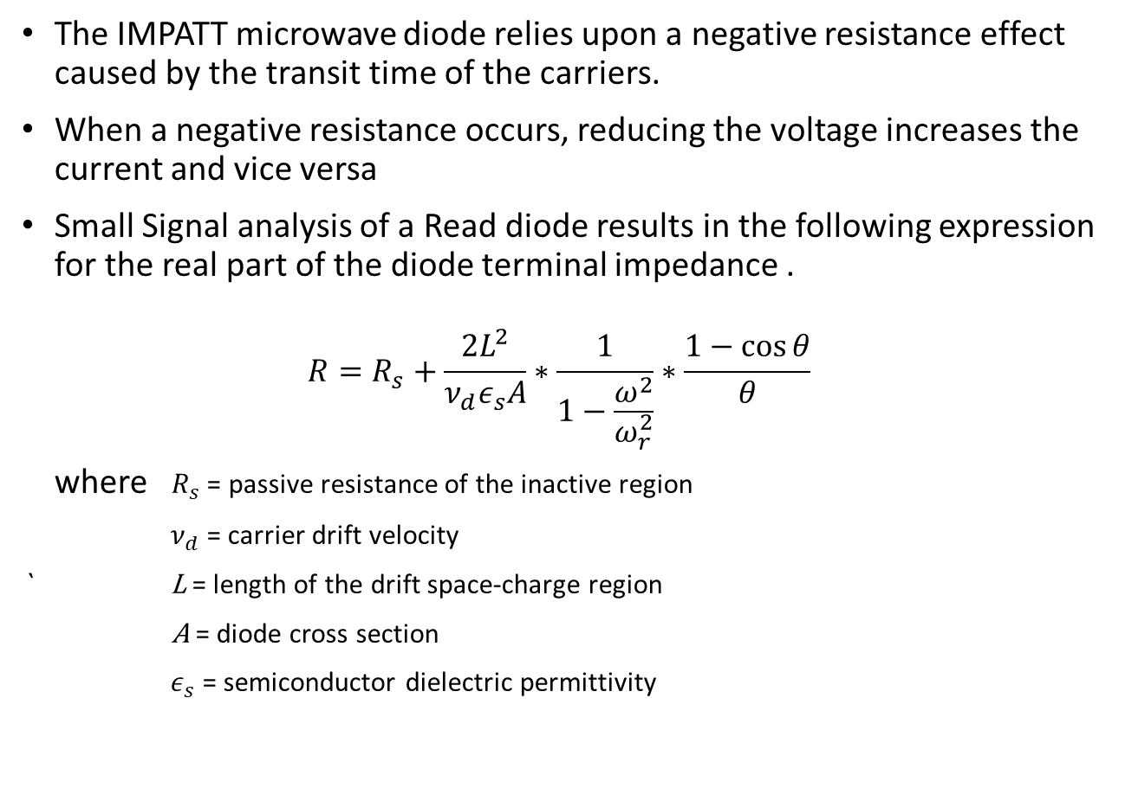
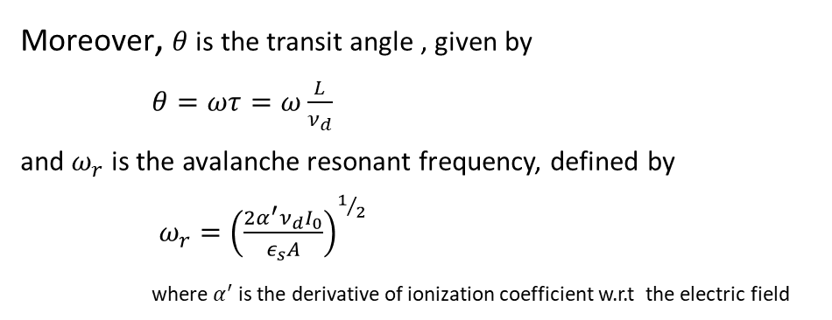
Negative Resistance
The IMPATT microwave diode relies upon a negative resistance effect caused by the transit time of the carriers.
When a negative resistance occurs, reducing the voltage increases the current and vice versa
Small Signal analysis of a Read diode results in the following expression for the real part of the diode terminal impedance .
$$R=R_{s}+\frac{2L^{2}}{ν_{d}ε_{s}A}∗\frac{1}{1−\frac{ω^{2}}{ω_{r}^{2}}}∗\frac{1−\cos{θ}}{θ}$$
where $R_{s}$ = passive resistance of the inactive region
${ ν}_{d}$ = carrier drift velocity
` L = length of the drift space-charge region
A = diode cross section
${ ε}_{s}$ = semiconductor dielectric permittivity
Moreover, $θ$ is the transit angle , given by
$θ=ωτ=ω\frac{L}{ν_{d}}$
and $ω_{r}$ is the avalanche resonant frequency, defined by
$ω_{r}={\left(\frac{2α^{′}ν_{d}I_{0}}{ε_{s}A}\right)}^{1/2}$
where $α^{′}$is the derivative of ionization coefficient w.r.t the electric field

Slide 11
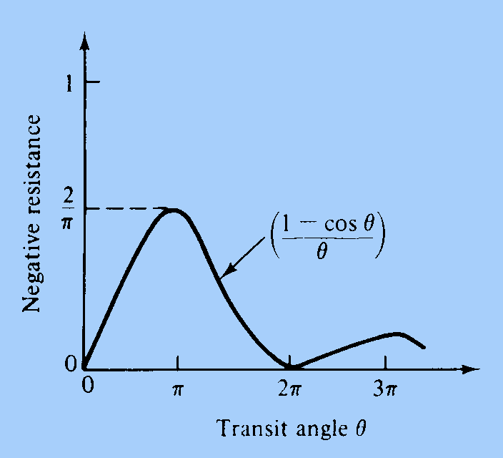
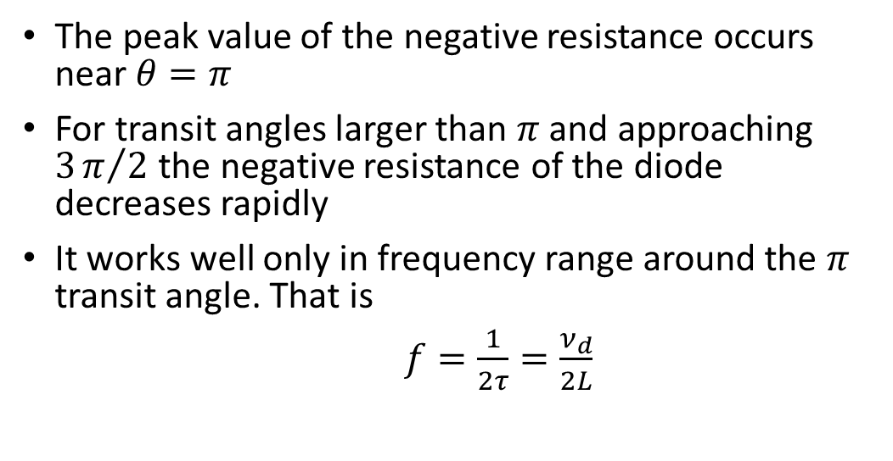

Cont....
The number of ionization per centimetre produced by a single carrier is a sharply increasing function of the electric field
When $ω>ω_{r}$we have the following plot
The peak value of the negative resistance occurs near $θ=π$
For transit angles larger than $π$ and approaching $3π/2$ the negative resistance of the diode decreases rapidly
It works well only in frequency range around the $π$ transit angle. That is
$f=\frac{1}{2τ}=\frac{ν_{d}}{2L}$

Slide 12
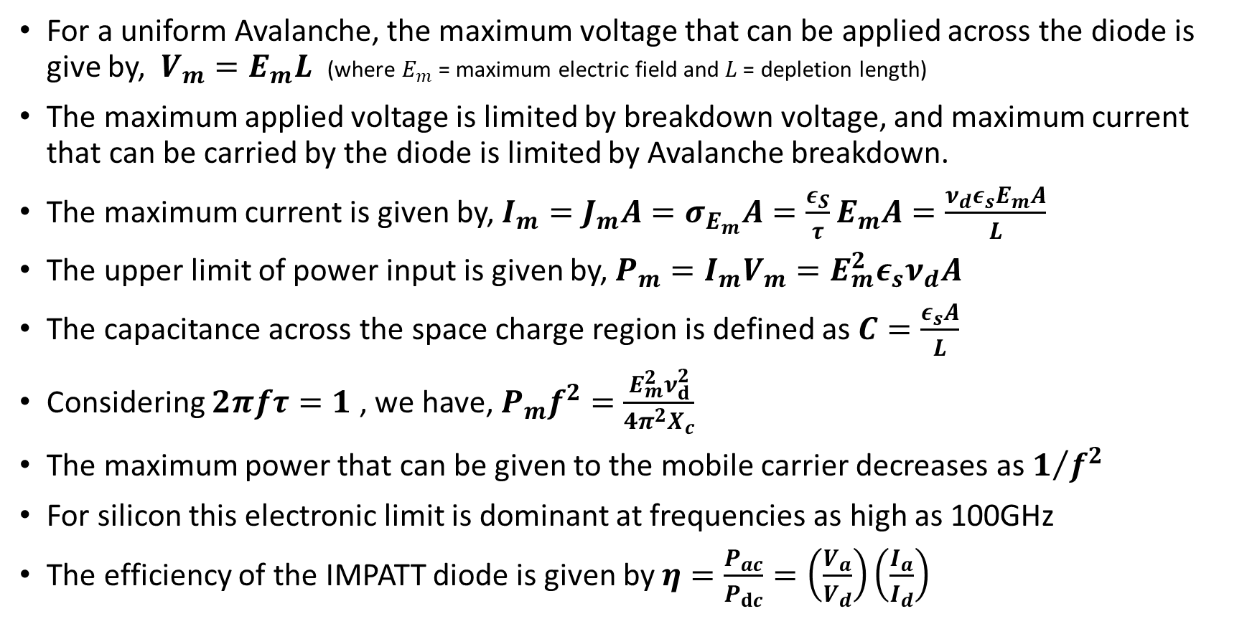
Power Output and Efficiency
For a uniform Avalanche, the maximum voltage that can be applied across the diode is give by, $V_{m}=E_{m}L$ (where $E_{m}$ = maximum electric field and $L$ = depletion length)
The maximum applied voltage is limited by breakdown voltage, and maximum current that can be carried by the diode is limited by Avalanche breakdown.
The maximum current is given by, $I_{m}=J_{m}A=σ_{E_{m}}A=\frac{ε_{S}}{τ}E_{m}A=\frac{ν_{d}ε_{s}E_{m}A}{L}$
The upper limit of power input is given by, $P_{m}=I_{m}V_{m}=E_{m}^{2}ε_{s}ν_{d}A$
The capacitance across the space charge region is defined as $C=\frac{ε_{s}A}{L}$
Considering $2πfτ=1$ , we have, $P_{m}f^{2}=\frac{E_{m}^{2}ν_{ⅆ}^{2}}{4π^{2}X_{c}}$
The maximum power that can be given to the mobile carrier decreases as $1/{f^{2}}$
For silicon this electronic limit is dominant at frequencies as high as 100GHz
The efficiency of the IMPATT diode is given by $η=\frac{P_{ac}}{P_{ⅆc}}=\left(\frac{V_{a}}{V_{d}}\right)\left(\frac{I_{a}}{I_{d}}\right)$

Slide 13
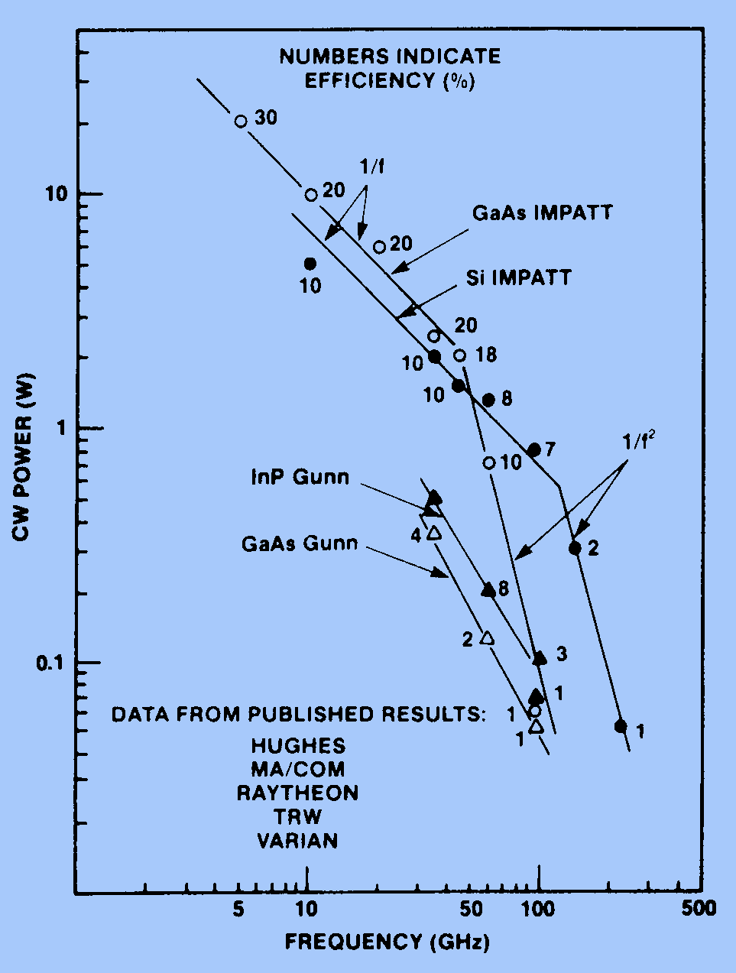
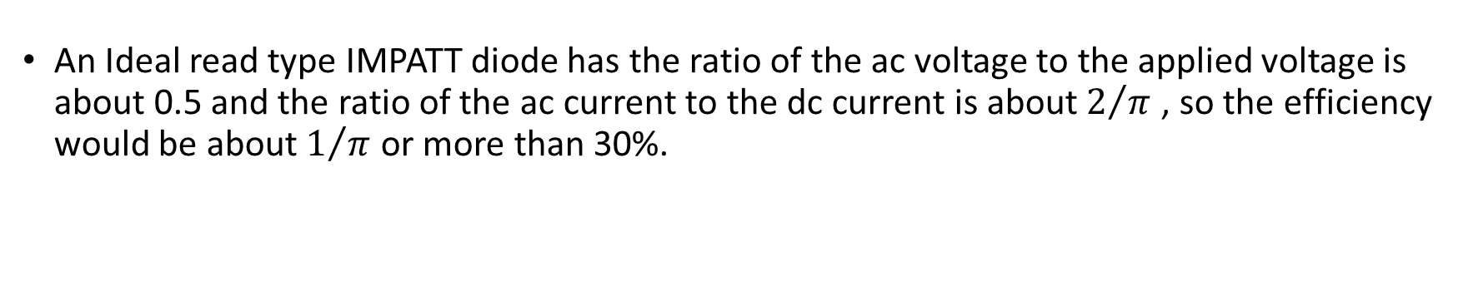
Cont.…
An Ideal read type IMPATT diode has the ratio of the ac voltage to the applied voltage is about 0.5 and the ratio of the ac current to the dc current is about $2/π$ , so the efficiency would be about $1/π$ or more than 30%.
For Practical IMPATT, the efficiency is less than 30%, because of the space-charge effect , the reverse-saturation-current effect, high frequency skin effect and the ionization-saturation effect
GaAs IMPATT performs better and has high power and efficiency in between frequency range of 40-60GHz
Si IMPATT performs better and has high power and efficiency above frequency of 60GHz

Slide 14
Advantages
It provides high operating range.
It shows compactness in size.
IMPATT diodes are economical.
It provides reliable operation at high temperature.
Disadvantages
The rate of generation of electron-hole pair in the avalanche region causes the generation of high noise. Thus makes the system noisy.
It offers a low tuning range.
It offers high sensitivity to different operating conditions.

Slide 15
TRAPATT Diode

Slide 16
TRAPATT Diode
TRApped, Plasma Avalanche Triggered Transit Diode
The TRAPATT diode is normally used as a microwave oscillator
It is a p-n junction diode characterized by the formation of a trapped space charge plasma within the junction region
It has the advantage of a greater level of efficiency when compared to an IMPATT microwave diode
Typically the DC to RF signal conversion efficiency may be in the region of 20% to 60% which is particularly high.
Frequency of operation is typically below about 10 GHz.
Advantage:- Higher efficiency
Disadvantage:- the noise levels on the signal are even higher than they are when using an IMPATT

Slide 17
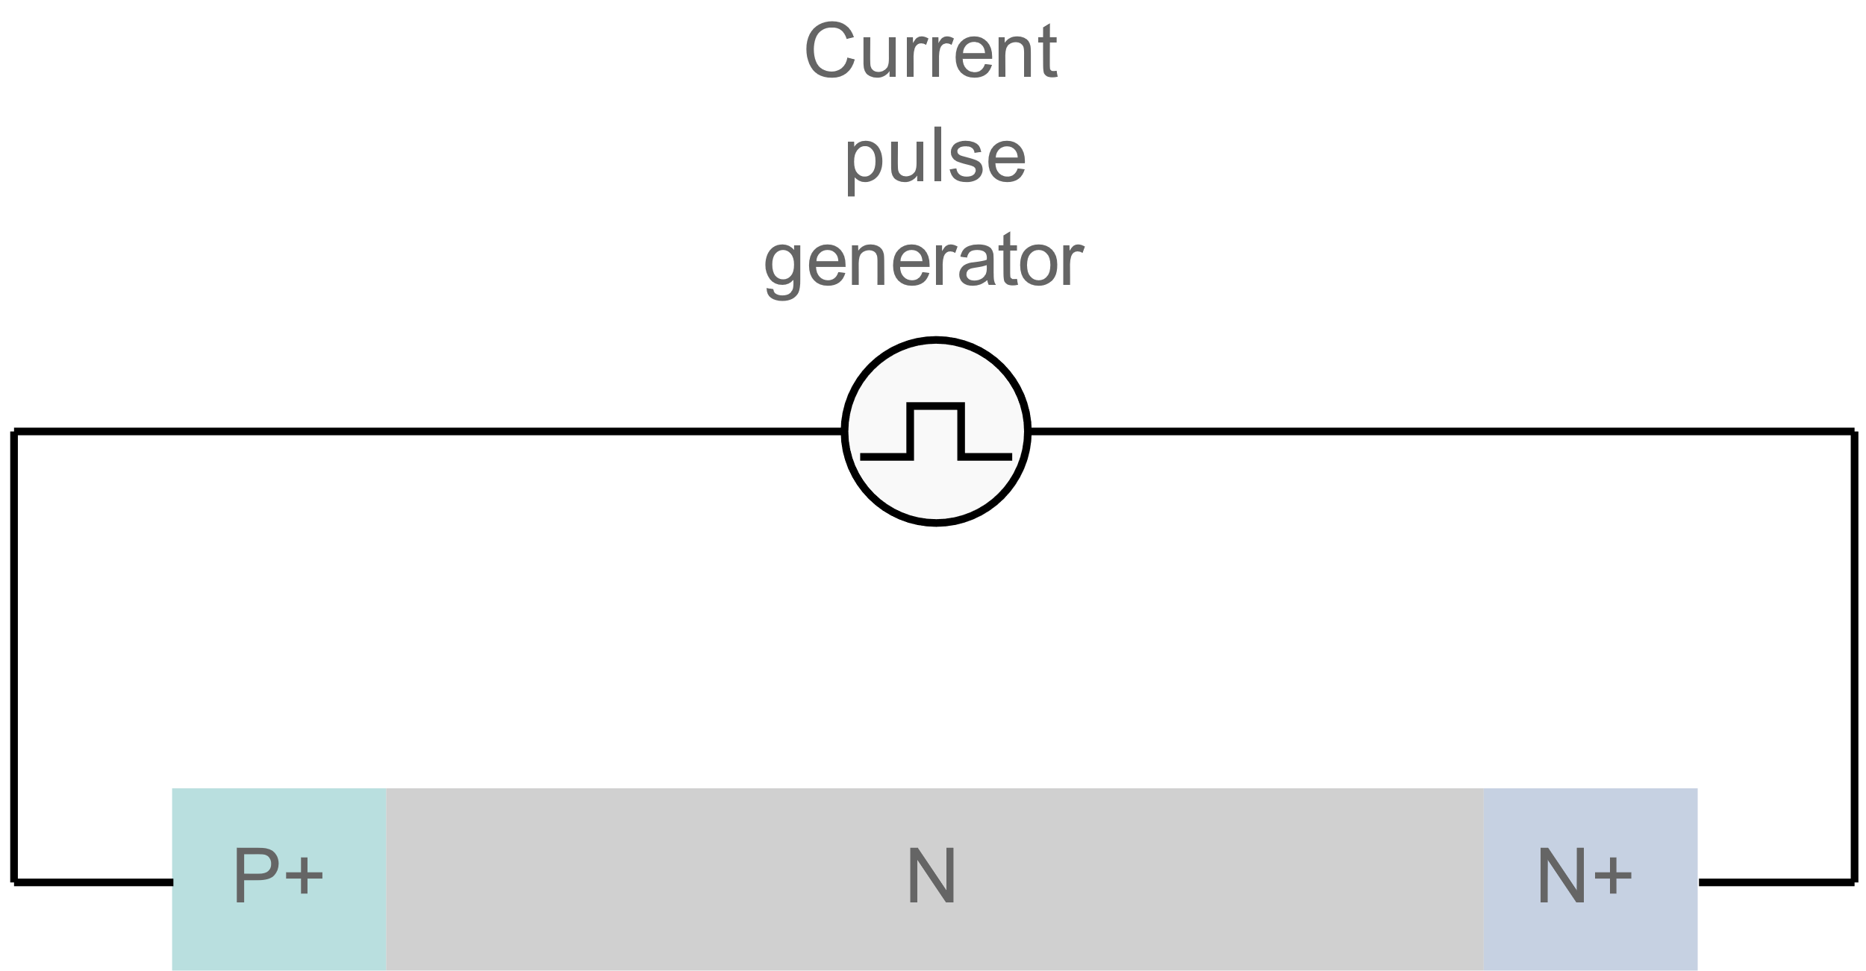
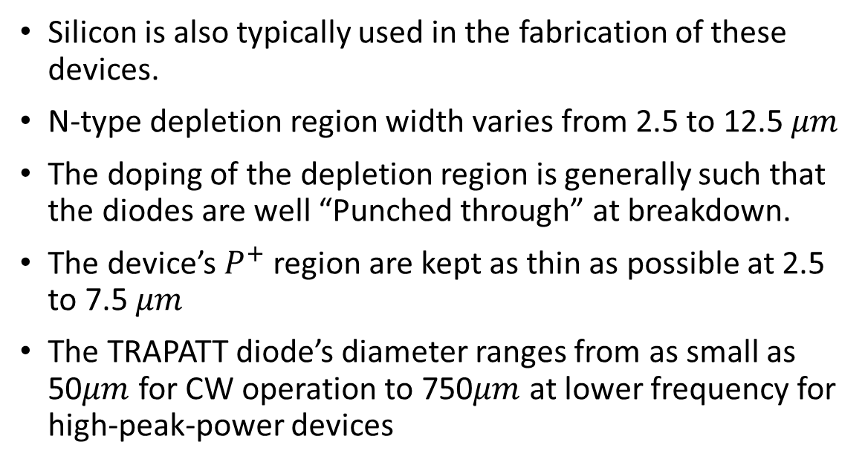
TRAPATT Diode Structure
The TRAPATT diode is based around the initial concept of the IMPATT but it has been enhanced by increasing the doping level between the junction and the anode.
Typically the construction of the device consists of a P+ N N+,( although where for higher power levels an N+ P P+ structure is better)
Silicon is also typically used in the fabrication of these devices.
N-type depletion region width varies from 2.5 to 12.5 $μm$
The doping of the depletion region is generally such that the diodes are well “Punched through” at breakdown.
The device’s $P^{+}$ region are kept as thin as possible at 2.5 to 7.5 $μm$
The TRAPATT diode’s diameter ranges from as small as 50$μm$ for CW operation to 750$μm$ at lower frequency for high-peak-power devices

Slide 18
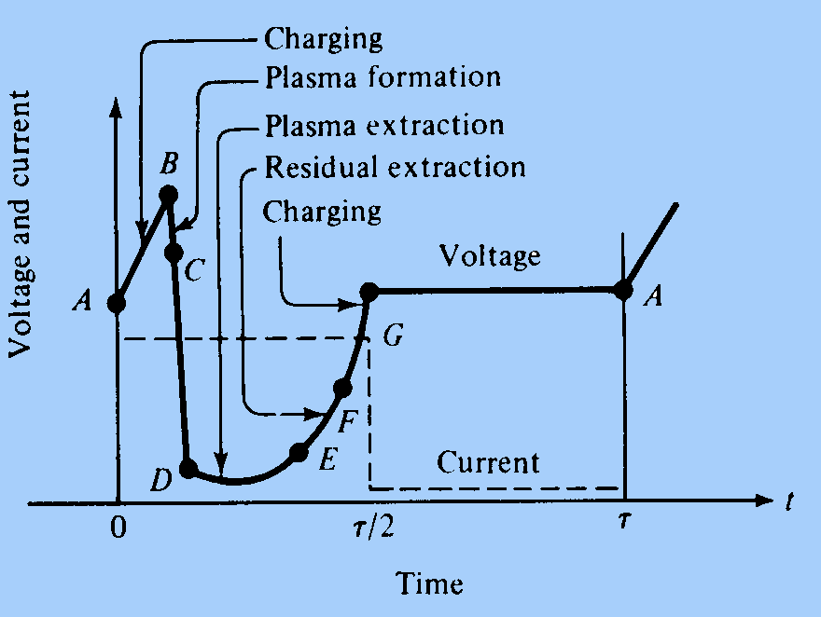
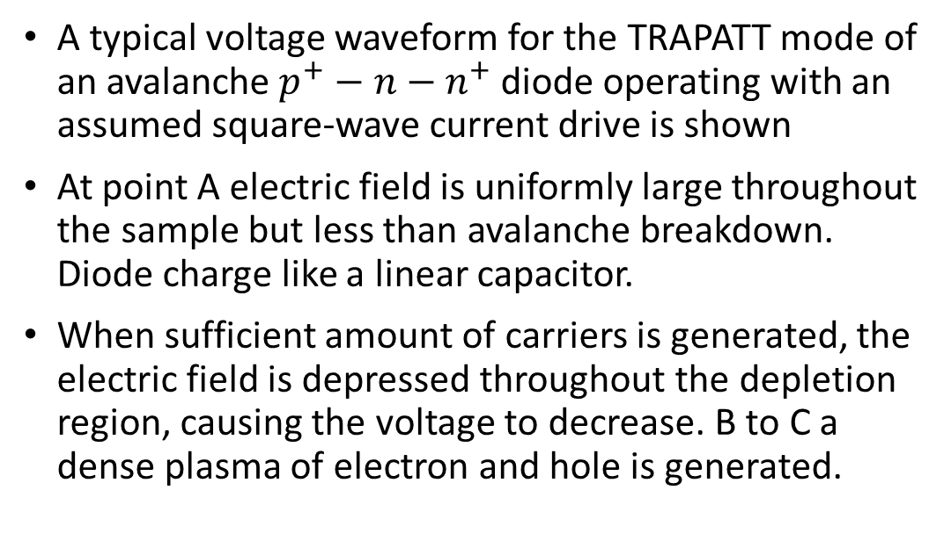
TRAPATT Diode operation
A high-field avalanche zone propagates through the diode and fills the depletion layer with a dense plasma of electrons and holes that become trapped in the low field region behind the zone.
A typical voltage waveform for the TRAPATT mode of an avalanche $p^{+}−n−n^{+}$ diode operating with an assumed square-wave current drive is shown
At point A electric field is uniformly large throughout the sample but less than avalanche breakdown. Diode charge like a linear capacitor.
When sufficient amount of carriers is generated, the electric field is depressed throughout the depletion region, causing the voltage to decrease. B to C a dense plasma of electron and hole is generated.

Slide 19
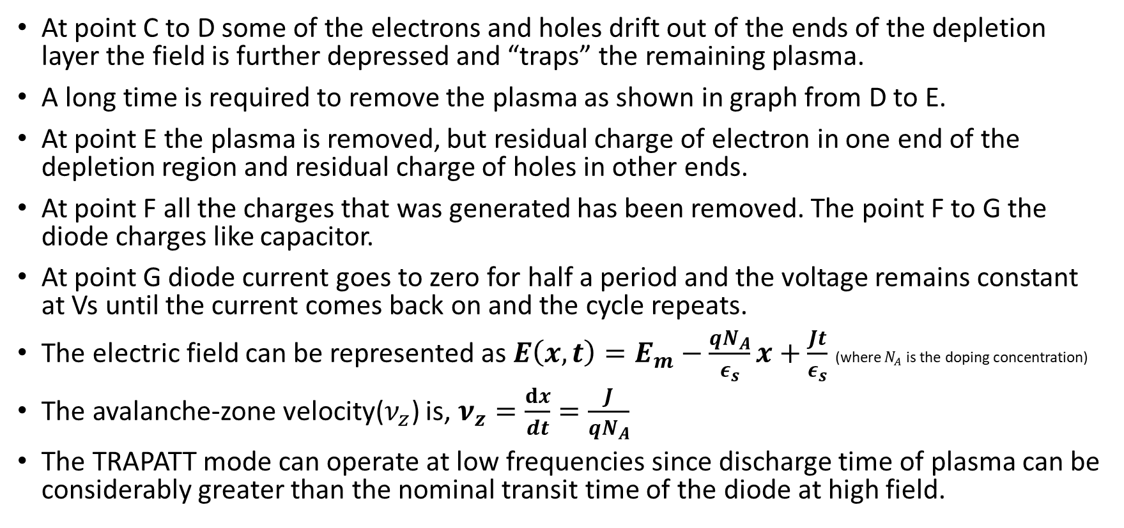
Cont.…
At point C to D some of the electrons and holes drift out of the ends of the depletion layer the field is further depressed and “traps” the remaining plasma.
A long time is required to remove the plasma as shown in graph from D to E.
At point E the plasma is removed, but residual charge of electron in one end of the depletion region and residual charge of holes in other ends.
At point F all the charges that was generated has been removed. The point F to G the diode charges like capacitor.
At point G diode current goes to zero for half a period and the voltage remains constant at Vs until the current comes back on and the cycle repeats.
The electric field can be represented as $E\left(x,t\right)=E_{m}−\frac{qN_{A}}{ε_{s}}x+\frac{Jt}{ε_{s}}$ (where $N_{A}$ is the doping concentration)
The avalanche-zone velocity($ν_{z}$) is, $ν_{z}=\frac{ⅆx}{dt}=\frac{J}{qN_{A}}$
The TRAPATT mode can operate at low frequencies since discharge time of plasma can be considerably greater than the nominal transit time of the diode at high field.

Slide 20
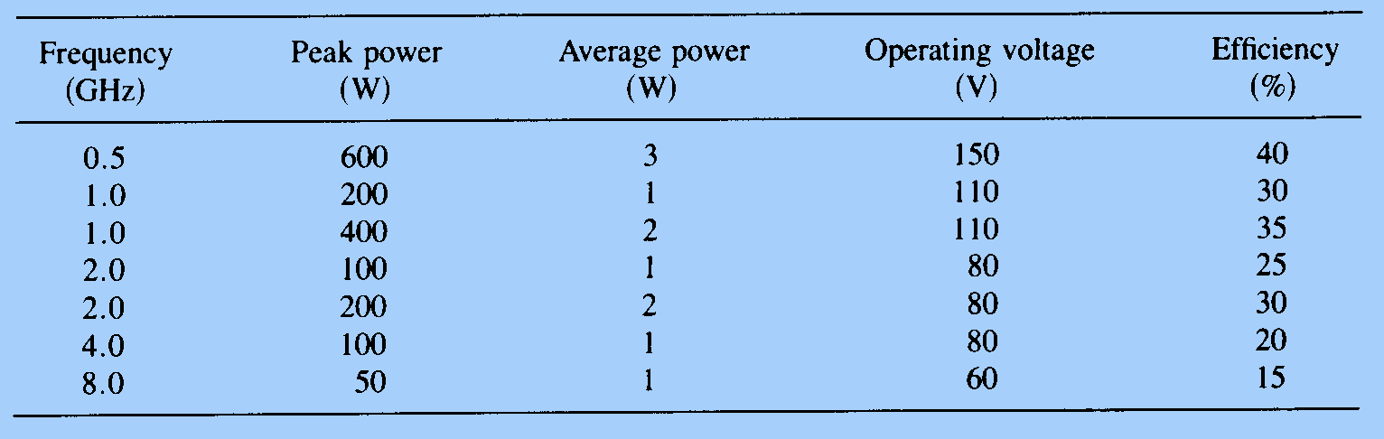
Power Output and Efficiency
RF power is delivered by the diode to an external load when the diode is placed in a proper circuit with a load.
The main function of this circuit is to match the diode effective negative resistance to the load at the output frequency while reactively terminating(trapping) frequency above the oscillation frequency in order to ensure TRAPATT operation.
To date, the highest pulse power of 1.2kW has been obtained at 1.1GHz, and the highest efficiency of 75% has been achieved at 0.6GHz

Slide 21
Advantages
20 to 60% efficiency is obtained
More suitable for pulsed operation
It is much higher level of efficiency than the IMPATT diodes.
Very low power dissipation.
It can operate between several hundred megahertz to several gigahertz
Disadvantages
Noise figure is greater than 30dB, it is also very noisy.
Not suitable for continuous operation because of its very high power densities.

Slide 22
References
(BOOK) Microwave Devices and Circuits by S.M. Liao.
(BOOK) Microwave Engineering, D.M. Pozar.
https://www.electronics-notes.com/articles/electronic_components/diode/impatt-microwave-diode-structure-fabrication-construction.php
https://www.electronics-notes.com/articles/electronic_components/diode/impatt-microwave-diode-how-does-impatt-work-theory-operation.php
https://www.electronics-notes.com/articles/electronic_components/diode/trapatt-diode-fundamentals.php

Slide 23
THANKS

